Slide 1
Paper Title : Timetable Generator Using AI Methods
Paper Id : 2503041
Presenter Category : Under Graduate (UG)
Authors Details
Mr.Akshay Jadhav,
Ms.Rupali Chavan
Mr.Parag Iwanate,
Ms.Sakshi Wani
Student - UG
Pune University,
Pune
Presented by
Ms.Sakshi Wani,
Student - UG
PUNE University,
PUNE

Slide 2
Key talking points
PRESENTATION FRAMEWORK
Abstract
Introduction
Literature Review
Methodology
Experiments / Analysis / Simulation etc
Results & Discussion
Conclusion
Paper ID : 2503041 Category : UG

Slide 3
ABSTRACT
This research paper discuss an innovative Automated Timetable Generator leveraging the synergistic capabilities of AI and advanced optimization algorithms. Automated Timetable Generator leveraging Decision Tree, K-Means Clustering, and Random Forest algorithms for efficient scheduling.
The Decision Tree algorithm is employed to classify and allocate time slots based on predefined constraints, ensuring that scheduling conflicts are minimized. K-Means Clustering is utilized to group subjects, faculty, and students based on similarities, optimizing resource allocation. The Random Forest model further enhances the accuracy and efficiency of scheduling by analyzing multiple possible allocations and selecting the best-fit timetable while ensuring fairness and balancing workload distribution.
The Automated Timetable Generator aims to efficiently generate conflict-free timetables for second-year, third-year, and final-year engineering students, considering their divisions, subject allocations, available faculty, classrooms, and practical labs. This system automates the scheduling process, ensuring that no two subjects, teachers, or classrooms overlap while optimizing resource utilization. By reviewing different research paper we identify the techniques, the automated timetable generator can efficiently handle complex scheduling requirements, reduce manual intervention, and produce balanced timetables that meet institutional constraints and preferences.
Paper ID : 2503041 Category : UG

Slide 4
Outline of Abstract :
Problem: Manual timetable scheduling is inefficient, error-prone, and leads to conflicts in subject, faculty, and classroom allocation.
Scope: The system automates timetable generation for second, third, and final-year engineering students, considering faculty availability, subject allocation, classrooms, and labs.
Strategy: Uses algorithmic techniques like constraint satisfaction and optimization to ensure conflict-free scheduling.
Plan: Collects institutional data, applies scheduling constraints, and develops an interactive system for automated timetable generation.
Solution: A smart, automated system that efficiently creates balanced and conflict-free timetables, reducing manual workload.
Benefits: Improves accuracy, eliminates scheduling conflicts, optimizes resource utilization, and enhances institutional efficiency.
Paper ID : 2503041 Category : UG

Slide 5
Introduction
Managing timetables manually in educational institutions is a complex and time-consuming task, often leading to scheduling conflicts, inefficient resource utilization, and administrative burdens.
The Automated Timetable Generator is designed to streamline this process by generating optimized, conflict-free schedules for second-year, third-year, and final-year engineering students. It considers key constraints such as subject allocations, faculty availability, classroom assignments, and practical lab sessions to ensure a structured and efficient timetable.
By leveraging intelligent algorithms, the system prevents scheduling conflicts, optimizes resource distribution, and minimizes manual effort. Additionally, it generates separate timetables for faculty members and labs, ensuring balanced workload distribution and eliminating overlaps. This solution enhances accuracy, improves efficiency, and provides a scalable, user-friendly platform for seamless academic scheduling.
Paper ID : 2503041 Category : UG

Slide 6
Literature Review
Web-Based Conflict Resolution: Automates timetable creation while resolving scheduling conflicts, improving accuracy and resource allocation.
Genetic Algorithms for Scheduling: Uses evolutionary computing to dynamically adjust schedules based on faculty availability and constraints.
AI vs. Traditional Methods: Compares automated and manual scheduling, highlighting AI’s efficiency in handling constraints.
Optimization Techniques: Evaluates different algorithms for scheduling problems, identifying strengths and weaknesses.
Automated Scheduling Systems: Focuses on minimizing human intervention and improving timetable accuracy.
OptiSchedule Algorithm: Uses optimization techniques to prevent class overlaps and balance faculty workload.
Manual vs. Automated Scheduling: Highlights inefficiencies of manual methods and advantages of automation.
Paper ID : 2503041 Category : UG

Slide 7
Literature Review
Mathematical Models: Uses algorithms to optimize faculty workload and time slot allocation.
AI & Machine Learning: Predicts optimal schedules based on past data, enhancing accuracy and flexibility.
Genetic Algorithms for Curriculum: Handles complex scheduling constraints efficiently using evolutionary computing.
AI-Based Scheduling Models: Reviews AI advancements and their impact on timetable automation.
Algorithmic Performance Analysis: Compares AI and machine learning techniques for improving scheduling accuracy.
Paper ID : 2503041 Category : UG

Slide 8
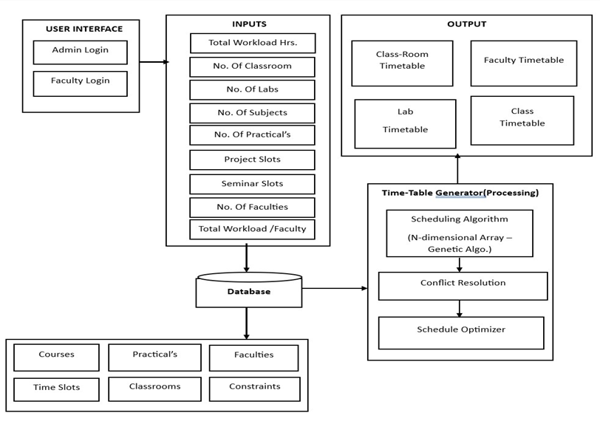
Methodology
Paper ID : 2503041 Category : UG

Slide 9
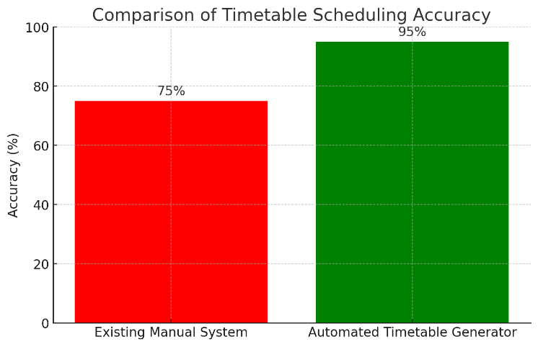
GRAPHS / TABLES / ANALYSIS / SIMULATION ETC
Paper ID : 2503041 Category : UG

Slide 10
Result & Discussion
The system ensures that no two classes , faculty members, or labs are scheduled at the same time, reducing manual errors.
Faculty members receive the individual schedules and practical lab sessions are assign efficiently without clashes.
The Web base system makes it easy for administrators to generate, edit,and manage timetables in real-time.
Automating the scheduling process significantly reduces the effort and time required compare to manual methods.
Paper ID : 2503041 Category : UG

Slide 11
Conclusion
The timetable generation system automates scheduling for classrooms, faculty, and labs using a database-driven approach and advanced algorithms like genetic algorithms. It efficiently allocates time slots while resolving conflicts and optimizing schedules. The system ensures fair workload distribution, minimizes clashes, and generates structured timetables for faculty, classrooms, and labs. With a user-friendly interface, it enhances efficiency, reduces manual effort, and improves academic planning.
Paper ID : 2503041 Category : UG

